Slide 1
Object Oriented Programming in C++ INHERITANCE
OBJECT ORIENTED PROGRAMMING, Spring 2024

Slide 2
INHERITING DATA MEMBERS OF BASE CLASS
EXAMPLE
BOXTYPE IS INHERITED FROM RECTANGE CLASS
Rectangle
Box

Slide 3
Base class
Derived class
class rectangleType
{
public:
void setDimension(double l, double w);
double getLength() const;
double getWidth() const;
double area() const;
double perimeter() const;
void print() const;
rectangleType();
rectangleType(double l, double w);
private:
double length;
double width;
};
class boxType: public rectangleType
{
public:
void setDimension(double l, double w, double h);
double getHeight() const;
double area() const;
double volume() const;
void print() const;
boxType();
boxType(double l, double w, double h);
private:
double height;
};

Slide 4
Constructor of derived class
boxType::boxType(double l, double w, double h): rectangleType(l, w)
{
if (h >= 0)
height = h;
else
height = 0;
}
Constructor of base class is called first:
rectangleType::rectangleType(double l, double w)
{length=l;
width=w;}
myBox1
Creating object of derived class:
boxType myBox1(10, 7, 3);
//pass parameters of base class as well as derived class
Length = 10
width = 7
height = 3

Slide 5
Default Constructor of derived class
boxType::boxType()
{
height = 0;
}
Default constructor of base class is called automatically
rectangleType::rectangleType()
{length=0; widht=0;}
Creating object of derived class using default values
boxType myBox2;
myBox2
Length = 0
width = 0
height = 0

Slide 6
Using base class functions in derived class
SetDimension function of base class
void rectangleType::setDimension(double l, double w)
{
if (l >= 0)
length = l;
else
length = 0;
if (w >= 0)
width = w;
else
width = 0;
}
SetDimension function of derived class
void boxType::setDimension(double l, double w, double h)
{
rectangleType::setDimension(l, w);
if (h >= 0)
height = h;
else
height = 0;
}

Slide 7
Calculating volume of Box
Double rectangleType::area() const
{
return length * width;
}
double boxType::volume() const
{
return rectangleType::area() * height;
}
Formula:
Volume of Box= length x width x height

Slide 8
double boxType::area() const
{
return 2 * (getLength() * getWidth()
+ getLength() * height
+ getWidth() * height);
}
Compiler will first search for getLength() function in derived class, if there is no function with this name, then base class function is automatically called

Slide 9
What is the difference between following two codes:
double boxType::volume() const
{
return rectangleType::area() * height;
}
double boxType::volume() const
{
return area() * height;
}

Slide 10
What is the difference between following two codes:
double boxType::volume() const
{
return rectangleType::area() * height;
}
double boxType::volume() const
{
return area() * height;
}
compiler will call area() function of derived class

Slide 11
Protected data members
The private members of base class are also private in derived class and cannot be directly accessed outside of the class
C++ provides a functionality that helps the derived class to access the base class members directly
If members of base class are made “protected” then derived class can access these members directly but such members cannot be accessed in other classes or functions

Slide 12
Example
int main()
{
rectangleType A1(2,3);
cout<<A1. length; // NOT OK
}
class rectangleType
{
public:
void setDimension(double l, double w);
double getLength() const;
double getWidth() const;
double area() const;
double perimeter() const;
void print() const;
rectangleType();
rectangleType(double l, double w);
protected:
double length;
double width;
};
Derived class member function:
double boxType::area() const
{
return 2 * (length * width + length * height + width * height);
}
Now base class members can be accessed directly

Slide 13
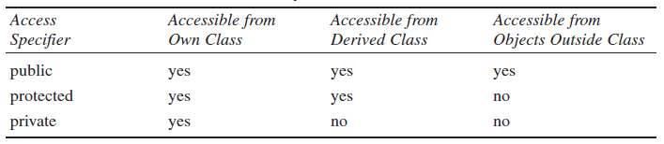
Types of Access Specifier- Summary

Slide 14
Accessibility modes and Inheritance
Public inheritance
Protected inheritance
Private inheritance

Slide 15
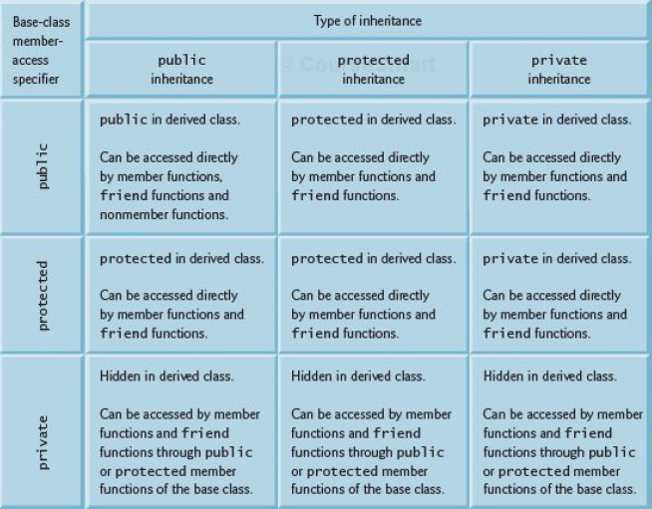

Slide 16
Public inheritance
CLASS A
CLASS B: Public A
Not inherited
x
Private members
Private members
Inherited as a protected
Protected members
Protected members
Inherited as a public
Public members
Public members

Slide 17
Public inheritance (Example)
class A
{
private: int a1;
protected: int a2;
public: int a3;
void SetA()
{a1=2;
a2=3;
a3=4;}
};
class B: public A
{
private: int b1;
public:
void print()
{
cout<<b1;
cout<<a1; //ERROR
cout<<a2;
cout<<a3;}
};
int main()
{
B bobj(1,2,3);
cout<<bobj.a3; //OK
cout<<bobj.a2; //NOT OK
bobj.SetA(); //OK
bobj.print(); // OK
};

Slide 18
Protected inheritance
CLASS A
CLASS B: Protected A
Not inherited
x
Private members
Private members
Inherited as a protected
Protected members
Protected members
Inherited as a protected
Public members
Public members

Slide 19
Protected Inheritance (Example)
class B: protected A
{
private: int b1;
public:
void print()
{
cout<<b1;
cout<<a1; //ERROR
cout<<a2;
cout<<a3;}
};
int main()
{
B bobj(1,2,3);
cout<<bobj.a3; //NOT OK
cout<<bobj.a2; //NOT OK
bobj.print(); // OK
bobj.SetA(); //NOT OK
};
class A
{
private: int a1;
protected: int a2;
public: int a3;
void SetA()
{a1=2;
a2=3;
a3=4;}
};
class C: public B
{
private: int c1;
public:
void print()
{cout<<b1; //not ok
cout<<a2; // OK
cout<<a3; //OK}
};

Slide 20
Private inheritance
CLASS A
CLASS B: Private A
Not inherited
x
Private members
Private members
Inherited as a private
Protected members
Protected members
Inherited as a private
Public members
Public members

Slide 21
Private Inheritance (Example)
class A
{
private: int a1;
protected: int a2;
public: int a3;
void SetA()
{a1=2;
a2=3;
a3=4;}
};
class B: private A
{
private: int b1;
public: int b2;
void print()
{
cout<<b1;
cout<<a1; //ERROR
cout<<a2;
cout<<a3;}
};
class C: public B
{
private: int c1;
public:
void print()
{cout<<b1<<a2<<a3;<<a1; //ERROR
cout<<b2; // OK}
};

Slide 22
Inheritance:Constructors & Destructors
When a base class and a derived class both have constructor and destructor functions
Constructor functions are executed in order of derivation –base class before derived class.
Destructor functions are executed in reverse order –the derived class’s destructor is executed before the base class’s destructor.
A derived class does not inherit the constructors of its base class.

Slide 23
